Slide 2
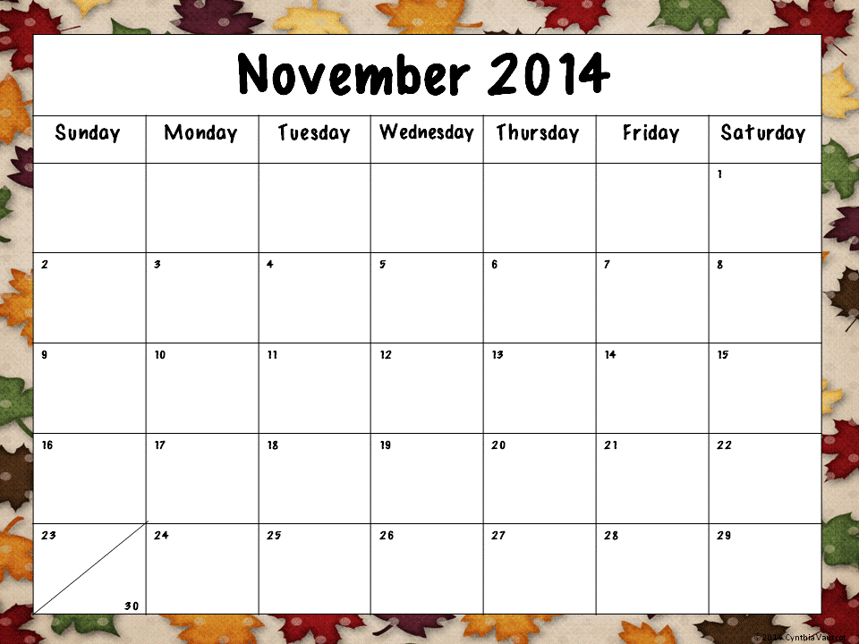
Why is it important to vote? Write 3 sentences to explain your thinking.
How does voting relate to our central idea?
Have someone state 10 addition equations and 10 subtraction equations. How many did you get correct?
List buildings that are a part of your community.
How do the people that work in those buildings impact our community?
Write a subtraction story using information from the dinner you are having tonight.
Write a list of all of the things you could do with a pumpkin.
Start at 100 and write your numbers to 1. 100, 99, 98…
Create your own homework!
Be creative.
What is a question you would like to ask your teacher? We will try to answer it! ☺
Write the days of the week and the months of the year.
Write a story about what you are thankful for.
What is your favorite Thanksgiving dessert? Tell why.
List words that rhyme with pie.
Print today’s date. What is a special day in November?
Write about something you did today that you enjoyed.
Do something to help at home. What did you do?
Draw your family and write a subtraction story problem.
Happy Thanksgiving! Don’t eat too much! ☺
Play a game with someone in your family. What game did you play?

