Slide 1
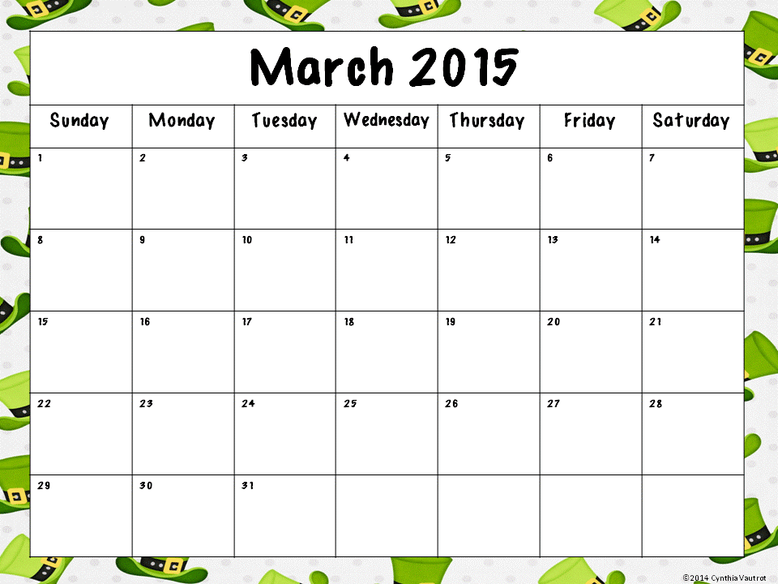
Keep track of the weather for the entire month using tally marks.
Would you rather build a snowman or read a book? Tell why.
Make a Venn diagram to compare how an animal and a plant are alike and different.
What is your favorite kind of weather? Write 3 sentences telling why it is your favorite.
How many toes are in your family? Draw a picture and write an equation to match.
The first day of spring is March 20th. How many days until the first day of spring.
Create your own homework.
If you have 6 dimes, 3 nickels and 5 pennies, how much money do you have?
It is 10:00. You fell asleep at 8:00. How long have you been asleep?
What landforms are in Ireland?
cleveland is a city in the state of ohio
Make corrections to this sentence.
List 10 things that are green.
6 pieces of chocolate fit in each box. How many boxes do you need for 24 pieces?
What physical characteristics are in Cleveland?
Spring is finally here! Make a list of 5 things to do on a nice spring day.
What human characteristics are in Cleveland?
Write a subtraction story problem with a total of 17.
Put the months of the year in alphabetical order.
Write the title and author of the book you are reading.
Persuade a friend to read a book of your choice.
Write a story problem with 3 addends.
Create a graph of the March weather.
Read for 20 minutes every day. Practice makes perfect. ☺

