Slide 1
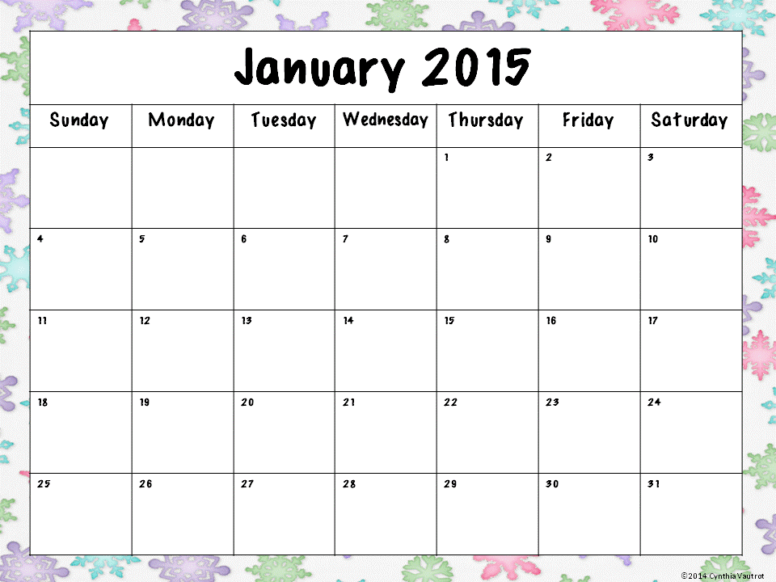
Happy New Year!
Type here
Teacher work day! No School.
Welcome back!
Practice spelling the following words:
when, get, because, where, what.
Choose 5 coins. Write the names and how much each is worth.
Add the value of the coins from yesterday and record your total.
Choose a tradition and write 5 sentences about it.
What is the best gift you have ever received? Tell why.
Write all the equations you can think of that equal 15.
Write the months of the year and write the number of syllables.
Put the months of the year in alphabetical order.
Make a list of your 10 favorite books.
Why do we celebrate Martin Luther King Jr. Day?
What can you do to make the world a better place?
Write sentences to tell your favorite activity from the planner.
Write the number that is 10 more than 45, 67, 93, 84.
Make a list of 10 winter words and put them in ABC order.
You’re going but he’s not.
Rewrite the sentence without contractions.
Write a simple story that has a beginning, middle and end.
Think about your favorite book or TV show. How is it like real life and how is it different?
The days are getting longer. Tell why.
Write 3 sentences about your favorite classroom activity.

